Slide 1

WELCOME

Slide 2
Introduction
RUVEL MOLLAH
Assistant Teacher
Rampur High School
Kapasia , Gazipur.
Class-Eight
Subject-English
Time-50 minutes
Date -15-02-2014 .

Slide 3
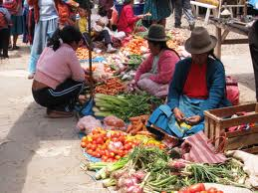

Slide 4
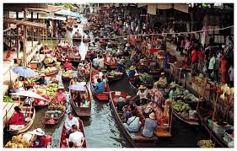
1. Can you guess what this could be ?
2. where do you thing this place is ?

Slide 5
Name of Lesson
Now we are going to read the today’s lesson about ’Floating market’
Unit –one,lesson-9, page-15

Slide 6
Learning out comes
After studied this lesson student will be able to
read and understand through silent reading.
describe about floating market.
write the environment of floating market.
Speak about the selling goods.

Slide 7
Presentation
Read the text and answer the questions.
1.what kind of market was it?
2.When did they reach the market ?
3.Where did they plan to have their break fast ?

Slide 8
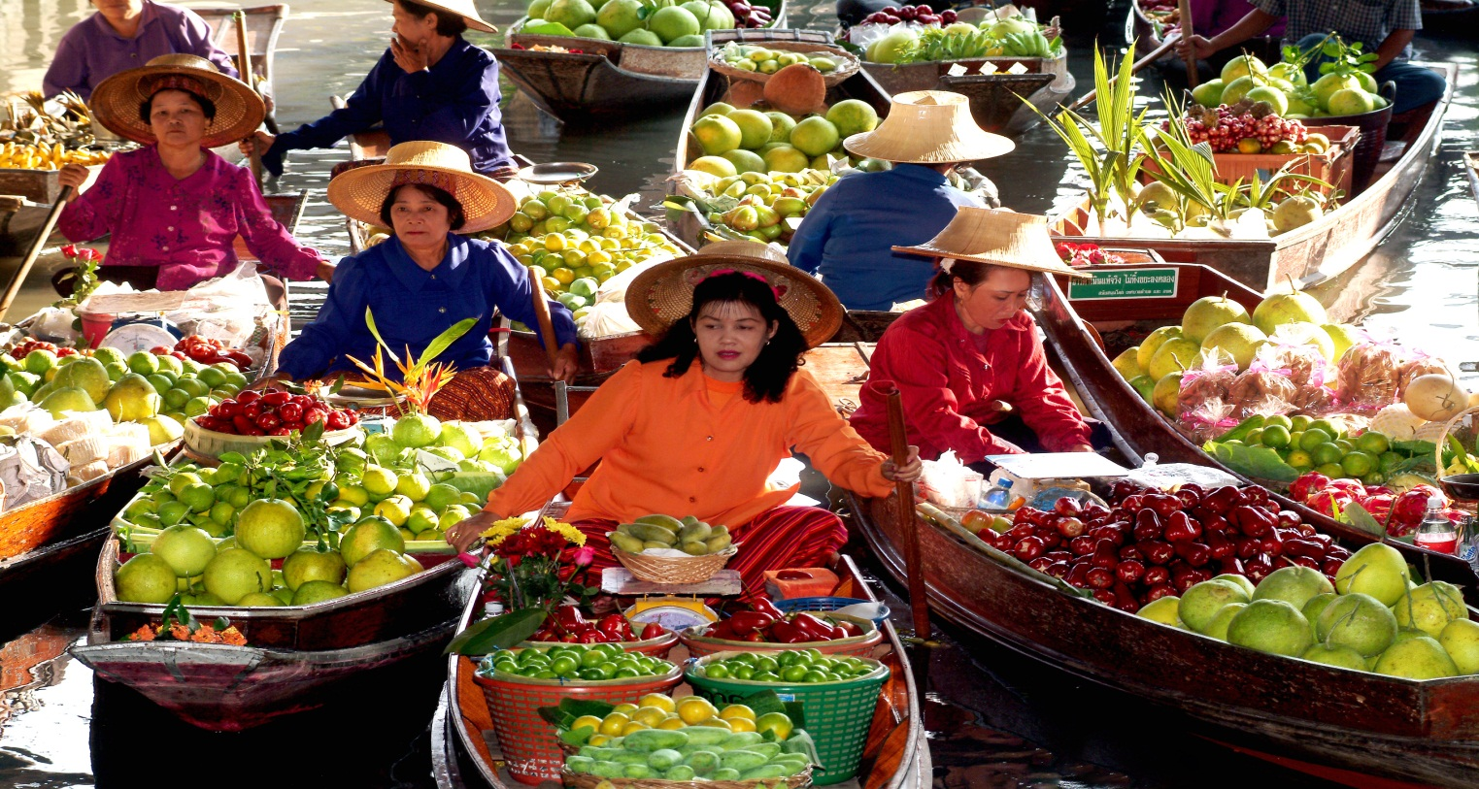
1. who were selling goods?
2. what were they selling ?
3. How were they selling their goods?
4. why did the boatman row slowly ?
5.How did they reach the center of the market ?

Slide 9
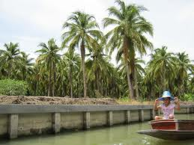
6.What did they see everywhere ?
7.with what were the canal surrounded ?

Slide 10
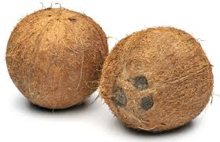

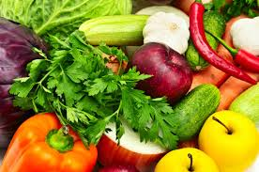
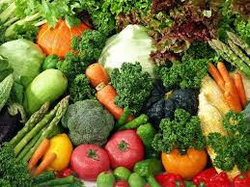
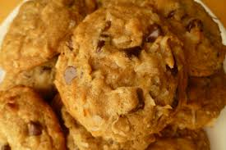
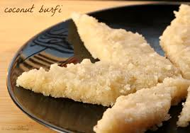

Slide 11
1. What kind of goods were selling in Tha Kha floating market?
2.what the small boats were laden with ?

Slide 12
Group work
Read the text further and write the main idea in group using the clues :- Woke up, started, planned, reached, surrounded ,hired ,rowed.

Slide 13
Evaluation
Write the answer individually closing your text book. A , who were sellers? B , How were they? c, Which things /goods did they sell ?d, How was the canal ?e, Who rowed the boat ?

Slide 14
Home Task
Describe a nearby bazar /market in your locality use the following clues :-location , variety of things found there , what kind of people go there , etc.

Slide 15
THANKS

